Slide 1
Building AI agents with langgraph

Slide 2
Agenda
What is an AI agent?
Intro to langgraph
Demo

Slide 3
What is agent?
An agent is an LLM that can reason about a goal, react to different situations, and operate across multiple steps.
Agents propose actions; systems decide what happens next.

Slide 4


Slide 5
What is langgraph?
LangChain helps you quickly get started building agents, with any model provider of your choice.
Langgraph is an orchestration framework for complex agentic systems and is more low-level and controllable than LangChain agents.
LangGraph allows you to control every step of your custom agent with :
low-level orchestration
Memory.
human-in-the-loop support.
LangChain builds agents; LangGraph governs how they run.

Slide 6
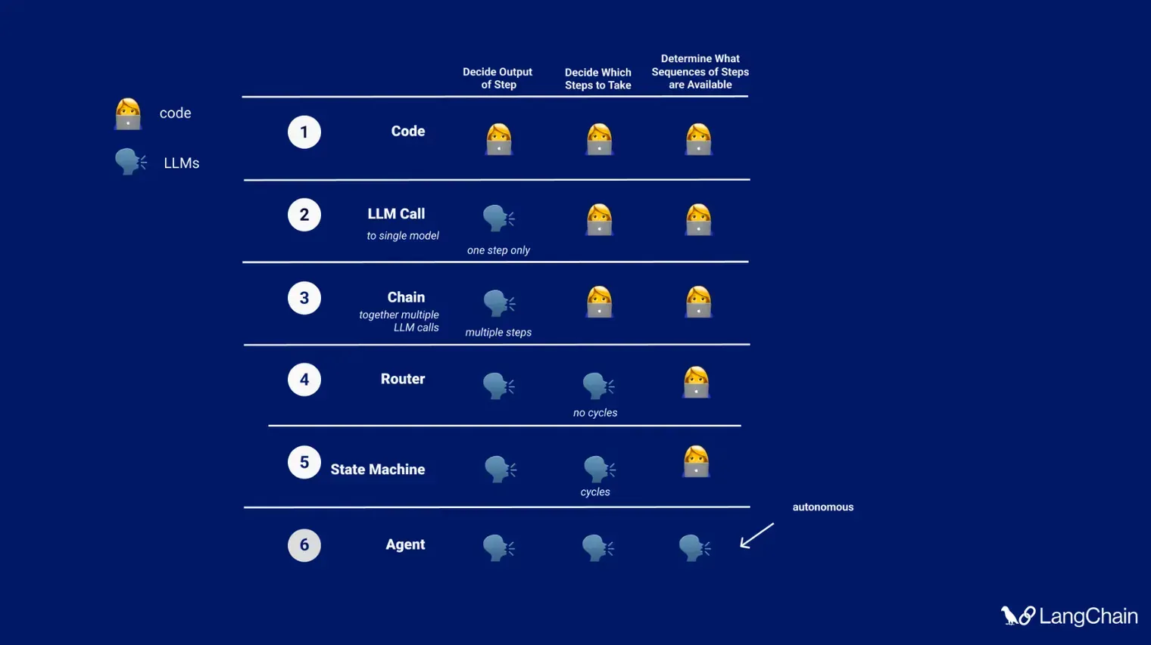

Slide 7
Motivation
DAG -> Graph

Slide 8

DAG -> Graph

Slide 9
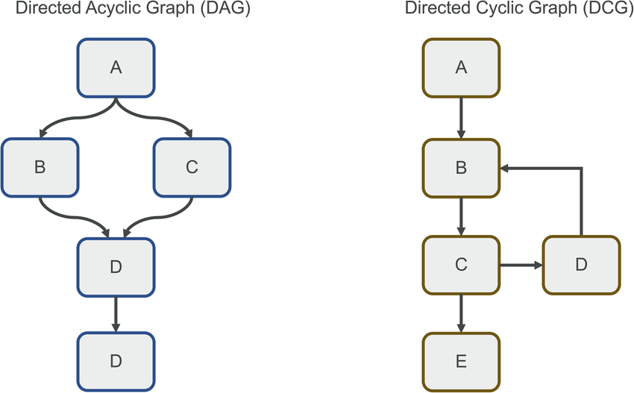
DAG -> Graph
https://www.researchgate.net/figure/Directed-Acyclic-Graphs-DAGs-left-and-Directed-Cyclic-Graphs-DCGs-right-The-latter_fig1_385310831

Slide 10
Motivation
Agent systems require cycles — retries, reflection, and correction.
Components:
State: shared data structure that flows through the graph.
Nodes: executable units of the graph.
Edges: define how execution moves from one node to the next.

Slide 11
Demo
Single VS multi agents system
Observability

Slide 12
What is langsmith?
LangSmith is a platform that helps AI teams use live production data for continuous testing and improvement. LangSmith provides:
Observability to see exactly how your agent thinks and acts with detailed tracing and aggregate trend metrics.
Evaluation to test and score agent behavior on production data and offline datasets for continuous improvement.
Deployment to ship your agent in one click, using scalable infrastructure built for long-running tasks

Slide 13
Motivation
doc

Slide 14
References
Chat models

